Slide 1
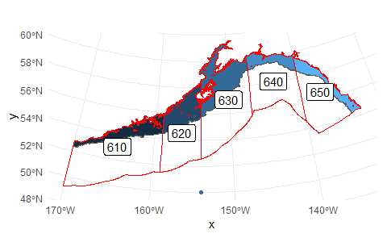
NEP 10km model (monthly)
ROMS runs:
Hindcast
“Historical" run
GFDL ssp126 projection
GFDL ssp585 projection
Depth ranges:
Surface (from 0 to 10 m)
Bottom (bottom to 10 m from bottom)
Midwater (10 m to 10 m from bottom)
Each management area to 1,000 m isobath

Slide 2
GOA Indices
Variable | NEP name
Ammonium | NH4
detritus concentration | Det
euphausiid concentration | Eup
euphausiid net production rate | prod_Eup
Iron concentration | Iron
Large copepod concentration | NCa
Large copepod production rate | prod_NCa
Large microzooplankton concentration | MZL
Large microzooplankton production rate | prod_MZL
Large phytoplankton concentration | PhL
Large phytoplankton production rate | prod_PhL
Time-averaged f ratio for large phytoplankton | frat_PhL
Nitrate | NO3
Salinity | salt
Small copepod concentration | Cop
Small copepod net production rate | prod_Cop
Small microzooplankton concentration | MZS
Small microzooplankton production rate | prod_MZS
Small phytoplankton concentration | PhS
Small phytoplankton production rate | prod_PhS
Time-averaged f ratio for small phytoplankton | frat_PhS
Temperature | temp
Summed across depth then averaged across area
Averaged across depth and area

Slide 3
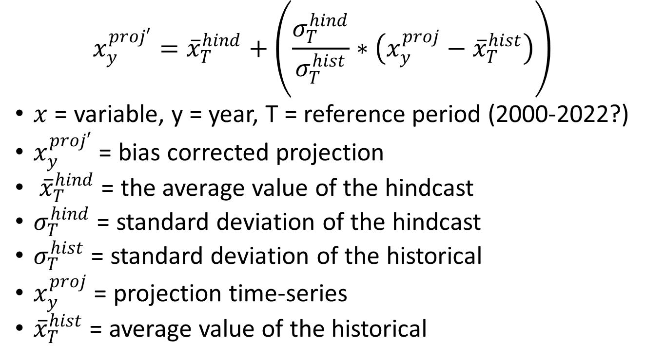
Delta correction (log?)
$$x_{y}^{proj′}={\overline{x}}_{T}^{hind}+\left(\frac{σ_{T}^{hind}}{σ_{T}^{hist}}∗\left(x_{y}^{proj}−{\overline{x}}_{T}^{hist}\right)\right)$$
$x$ = variable, y = year, T = reference period (2000-2022?)
$x_{y}^{proj′}$ = bias corrected projection
${\overline{x}}_{T}^{hind}$ = the average value of the hindcast
$σ_{T}^{hind}$ = standard deviation of the hindcast
$σ_{T}^{hist}$ = standard deviation of the historical
$x_{y}^{proj}$ = projection time-series
${\overline{x}}_{T}^{hist}$ = average value of the historical

